Slide 1
Java SE 8 Book Presentation
Chapter 9 – Arrays and ArrayLists

Slide 2
9.1 Declare, instantiate and use a one – dimensional array – 9.1.1 Declaring array variable
What is array ? (Object contains a number of values with unified data type)
Array can’t contain any other values with other datatypes
An array can also contain reference variable
An array declaration = Specifying the type of value that the array will contain (using “[]” symbol)
(code illustration snippet 1 – 2 – 3 – 4)

Slide 3
9.1 Declare, instantiate and use a one – dimensional array – 9.1.2 Creating and initializing array object
(code illustration snippet 5 – 6)
Everything after the “=“ sign will be called an array creation expression. This expression will allocate memory to hold the number of values specified in the expression (all initial values in the array are default values)
Since all values in the array are default values => array could have “duplicative value”
All array creation expressions don’t create any instances of the element inside the array
(code illustration snippet 7)
Since all arrays are an objects (instances) of a certain class => JVM cooks these name too, based on the following rules

Slide 4
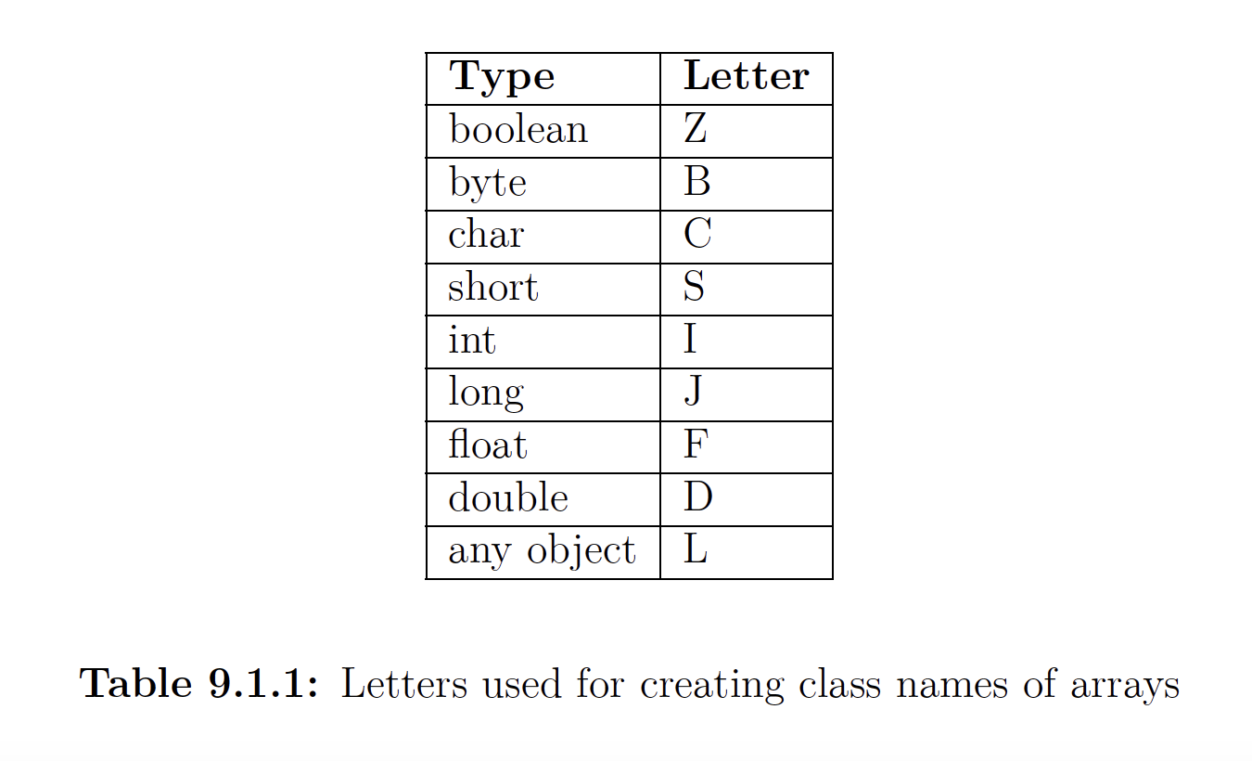
9.1 Declare, instantiate and use a one – dimensional array – 9.1.2 Creating and initializing array object

Slide 5
9.1 Declare, instantiate and use a one – dimensional array – 9.1.2 Creating and initializing array object
(code illustration snippet 8)
We can also initialize the array on the right-hand side of the “=“ sign using something called array initializer (also called “shortcut”)
Type specification for the value on the array initializer isn’t needed
The compiler can also determine the size of the array based on the array initializer
(code illustration snippet 9 – 10)

Slide 6
9.2 Using arrays – 9.2.1 Array indexing
- Index starts from 0, accessing the element of the array using the following syntax:
“<array name> + [index]”
- Exception will happen if the index is out of range
– Array can have a length of 0

Slide 7
9.2 Using arrays – 9.2.2 Members of an array object
All array classes has 2 members:
+) Array length – the object field of the class
+) Array cloning – the method to copy array (the name of this method is clone)

Slide 8
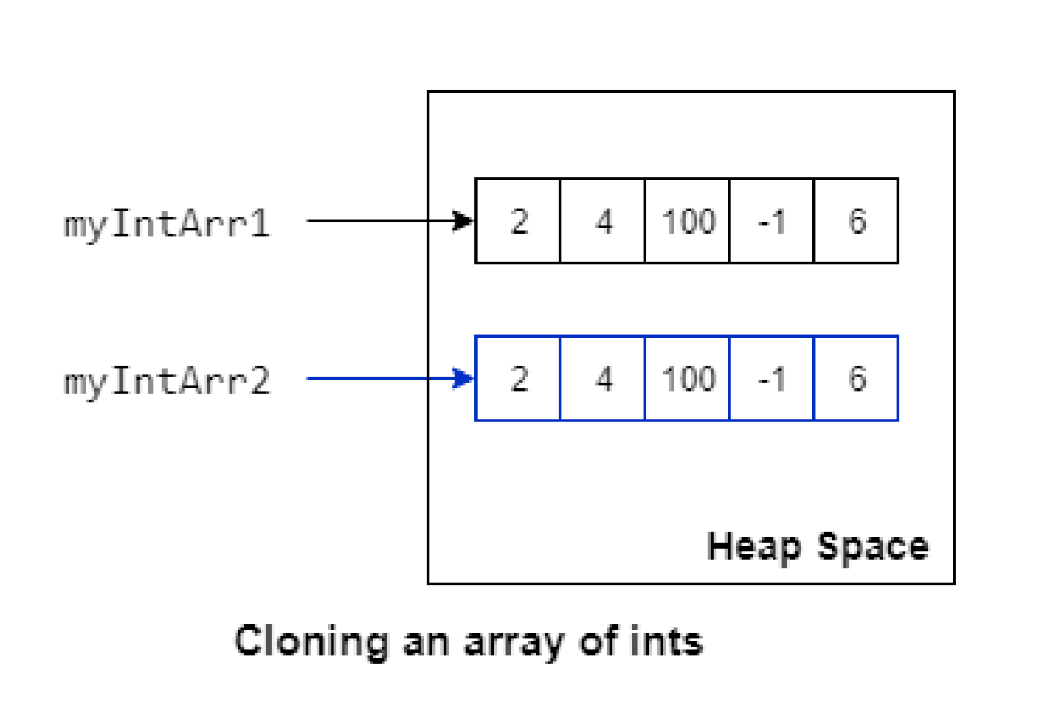
9.2 Using arrays – 9.2.2 Members of an array object

Slide 9
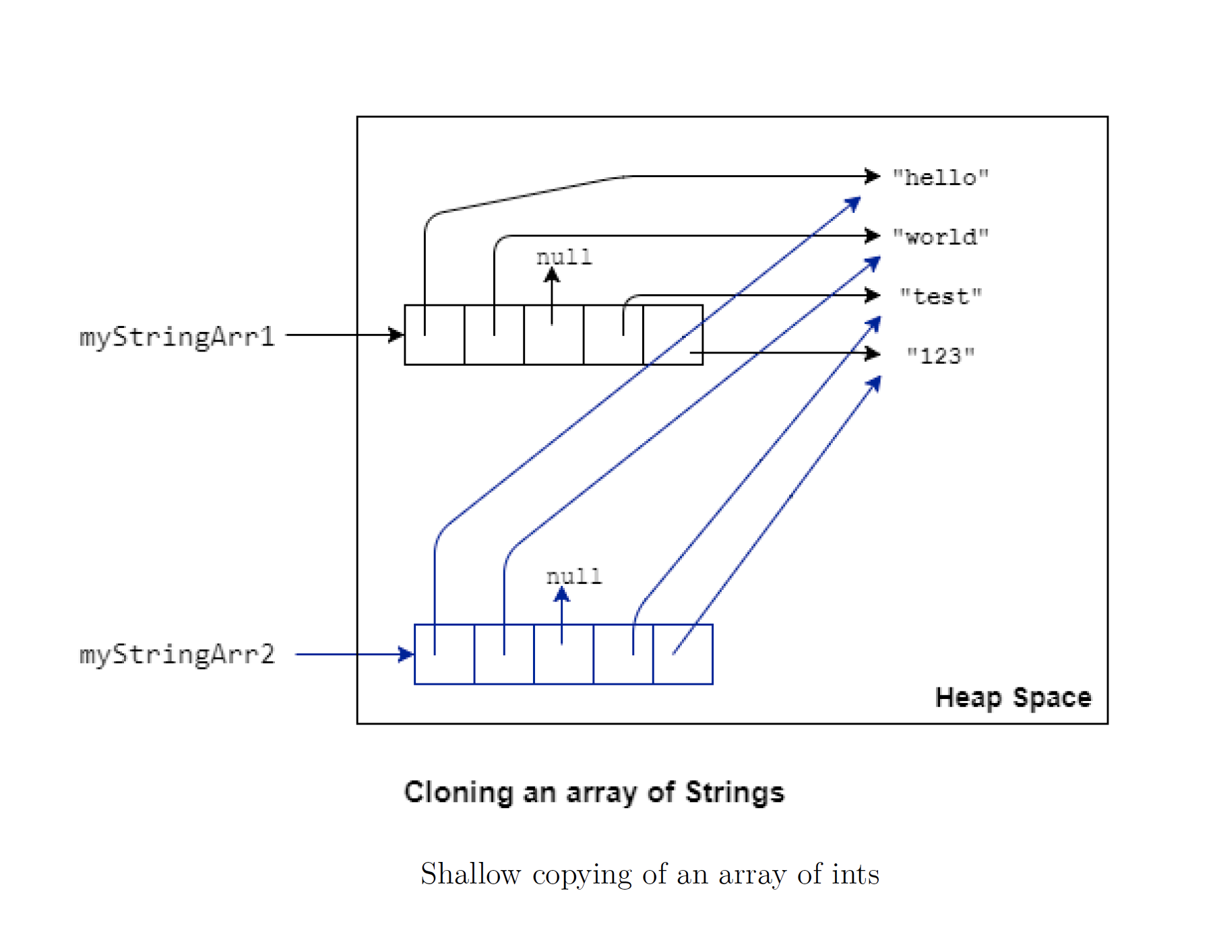
9.2 Using arrays – 9.2.2 Members of an array object

Slide 10
9.2 Using arrays – 9.2.2 Members of an array object
Since java.lang.Object is the superclass of all class => all array classes are also inheriting this superclass

Slide 11
9.2 Using arrays – 9.2.3 Runtime behavior of arrays
- Type checking of the array is done during the runtime not compile time => all information is maintained in bytecode for JVM to handle
(code illustration snippet 11)
- Another aspect of the array is that they are covariant

Slide 12
9.2 Using arrays – 9.2.4 Uses of arrays
- Array is powerful for DSA, but it is also simple enough to be considered as a primitive datatype => It is used for other datatypes too (e.g String)
- Array is also used to build other DSA such as Queue or Stack or List
When we talk about List, we are mentioning ArrayList => These classes are mostly used in application program instead of raw array
Java also have a special class called java.util.Arrays class => makes thing easier when working with raw array

Slide 13
9.3 Create and manipulate an ArrayList - 9.3.1 Introduction to Collections and Generics
We have mentioned about array – allows us to store multiple objects with a unified datatype, however, array has some disadvantages
+) Unchangable size
+) Adding a single value to a certain position in an array is “hard”
Although these disadvantages can be overcome by writing more code => Multiple code repeated => Bad => ArrayList solve these issues
(code illustration snippet 13)
Collections and Collections API
ArrayList belong to a group of class called collections – it just a group of different types of objects grouped into a unified form factor (take a supermarket bag for example) => Collections is the same with the supermarket bag (it just containing and doesn’t care about other things)
All “supermarket bag behavior” is captured by an interface called “Collections”
- What if we want more types of collections with more features bundled ? (mention about subinterfacing/subclassing) => these inherited/implemented classes are called Collections API

Slide 14
9.3 Create and manipulate an ArrayList - 9.3.1 Introduction to Collections and Generics
- ArrayList implements a subinterface (extended from Collections interface) called List (has all behavior from the Collections interface but with some additional features)
However, since an interface requires a class to implement all of the behaviors, ArrayList is a class that implements the List interface (ArrayList use an array inside it, also mention about the mechanism of the ArrayList)
Generic
- Observe the loop that we just illustrated, the type of the variable “o” is Object => to invoke the method “length()” on the element in the ArrayList, we must cast it back to the appropriate form
(but why the type of the variable is Object ?, mention again about the supermarket bag thing)
- If we have an ArrayList passed as an argument (this ArrayList is written by other developer and all elements are also added by the developer) => trying to cast to inappropriate from => ClassCastException
When we try to compile the code, a warning will be given (explain about the warning thing)
- Java solved this issue using “Generic”
(code illustration snippet 14 – 15)

Slide 15
9.3 Create and manipulate an ArrayList - 9.3.2 ArrayList APIs
- There are 3 types of constructor used in ArrayList class:
+) “ArrayList()” – empty list with initial capacity of 10
+) “ArrayList(Collection c)” – list with content from other Collection
+) “ArrayList(int initialCapacity) – list with customizable capacity (talk about the advantage of this)
To improve the efficiency, we can also use the method “ensureCapacity()”
(talk about the trimToSize() method)
(code illustration snippet 16)
Some important methods for ArrayList
Method to add elements to an ArrayList
String toString()
boolean add(E e)
void add(int index, E element)
Boolean addAll(Collection<? extends E> c) -> (code illustration snippet 17)

Slide 16
9.3 Create and manipulate an ArrayList - 9.3.2 ArrayList APIs
Boolean addAll(int index, Collection<? extends E> c) -> (code illustration snippet 18)
Method that removes element from the ArrayList
E remove(int index) -> (code illustration snippet 19)
boolean remove(Object o) -> (code illustration snippet 20)
boolean remove(Collection<?> c) -> (code illustration snippet 21)
void clear()
Method that replace element in the ArrayList
E set(int index, E element)
Method that read an ArrayList without mutate it
boolean contains(Object o)

Slide 17
9.3 Create and manipulate an ArrayList - 9.3.2 ArrayList APIs
E get(int index)
int indexOf(Object o)
boolean isEmpty()
int size()
Some important point about ArrayList
Exception: No exception will be thrown (except toArray(T[] a)
Adding null: ArrayList allows adding nulls
Adding duplicative value: Java allows adding duplivative value
(quiz from snippet 22 – 28)

Slide 18
9.3 Create and manipulate an ArrayList - 9.3.2 ArrayList APIs
Some important point about ArrayList
- Size is the number of element in the ArrayList
- Capacity is the length of the internal array inside ArrayList
- Adding element to the ArrayList depends on the size not the capacity

Slide 19
9.4 Traversing the elements of an ArrayList
(code illustration snippet 29)
ArrayList has a special method called “iterator” => return “java.util.Iterator” object
=> It has 2 methods “hasNext()” and ”next()”

Slide 20
9.5 ArrayList VS Array
Advantages
– Dynamic Sizing
– Type Safety
- Readymade feature
Disadvantage
– Higher memory usage
– No type safety
- !Primitive value
Similarity
– Ordering
Performance
”nulls”

